Slide 1
494(P)-AVI-01: Avionics Configuration
Trainee Preparation
Ashilta
29 Sep 2020
29 Mar 2020

Slide 2
Lesson Overview
Using the HSI
Aligning the INS
Configuring TACAN
Configuring the HUD
Using the IFEI
494(P)-AVI-01

Slide 3
Using the HSI
Understanding the HSI
Configuring the HSI
Programming Steerpoints
Using Sequences
494(P)-AVI-01

Slide 4
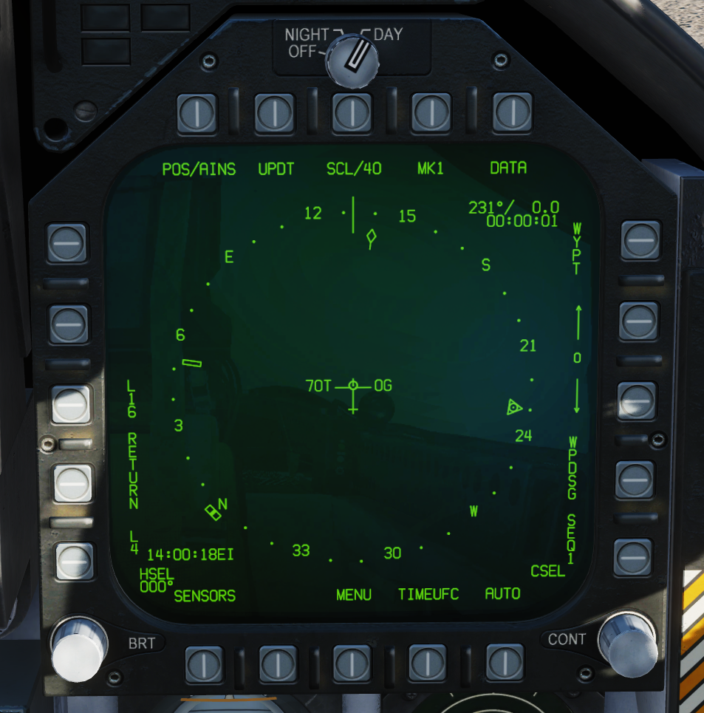
Understanding the HSI
The Horizontal Situation Indication (HSI) provides a top-down depiction of your aircrafts lateral position, flight plan and navigational aids.
It is available from the SUPPORT menu of the MFD, accessed via OSB 18.
494(P)-AVI-01

Slide 5
Understanding the HSI
The HSI displays:
TACAN bearing, range and ‘time to run’ information in the top left, if available
WAYPOINT bearing, range and ‘time to run’ information in the top right, if available.
The currently selected waypoint, on the right side of the display.
True airspeed, left of the position indication
Groundspeed, right of the position indicator
A compass rose, orientable either ‘Track up’ (default) or ‘North up’.
The relative location of the selected TACAN and Waypoint, if available.
The route between steerpoints in a sequence, if selected.
A full depiction of the information available on the HSI Main Page is available in Part 15, Section 3 of Chuck’s Guide.
494(P)-AVI-01

Slide 6
Understanding the HSI
Data relating to the HSI can be configured using the ‘DATA’ page, accessed using OSB 10. The HSI Main Page can be accessed by pressing OSB 10 again.
The HSI Data page displays:
The Latitude and Longitude of the currently selected waypoint.
The MGRS Grid reference for the currently selected waypoint.
The elevation of the currently selected waypoint
Offset range, bearing, grid and elevation information for the currently selected waypoint (not currently functional).
The HSI Data page can also be used to configure a number of options for the HSI.
494(P)-AVI-01

Slide 7
Understanding the HSI
The HSI provides capabilities for managing waypoints in the following formats:
Degrees Decimal Minutes (DD MM.MM”) to two decimal places
Degrees Decimal Minutes (DD MM.MMMM”) up to four decimal places
Degrees Minutes Seconds (DMS – DD MM’ SS”)
The HSI can store up to 60 conventional waypoints (0-59 inclusive) and up to 9 Markpoints.
494(P)-AVI-01

Slide 8
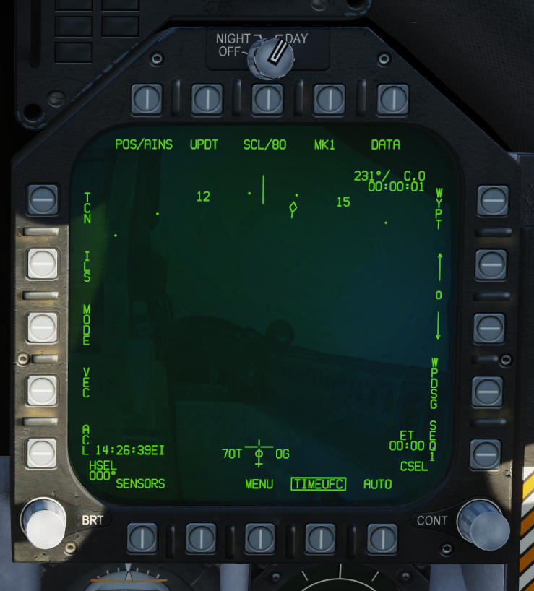
Configuring the HSI
The ‘MODE’ option from the HSI Main page allows the HSI display itself to be configured. Options are available for Track Up, North Up, Map toggle (only available if HSI is displayed on the AMPCD), Decluttered view and ‘Slew’ (not implemented).
The Decluttered view (DCTR) positions the aircraft’s location on the bottom of the HSI display, depicting the space ‘ahead’ of the aircraft in a cone of approximately 80 degrees.
494(P)-AVI-01

Slide 9
Configuring the HSI
When both TACAN and Waypoint information is correctly configured, ‘TCN’ (OSB 5) or ‘WYPT’ (OSB 11) can be selected (or ‘boxed’) to select that navigational aid for navigation.
Only one navigation aid can be boxed at a time. The boxed aid will add a caret to the HUD heading tape, indicating the relative bearing directly to the navigation aid.
The scale or display range of the HSI can be cycled by pressing OSB 8. The minimum range is 5 nautical miles; the maximum is 160.
494(P)-AVI-01

Slide 10
Configuring the HSI
Steerpoint data is configured using the Data page, accessed using OSB 10 on the HSI page.
The currently selected waypoint is shown on the right side of the HSI page – both the Main page and the Data page. The waypoint can be changed using the up and down arrows at OSBs 12 and 13.
As the waypoint is selected, the waypoint data shown on the Data page will change in real time.
Waypoint precision – when in Degrees Decimal Minutes mode – can be toggled by boxing ‘PRECISE’ at OSB 19.
494(P)-AVI-01

Slide 11
Configuring the HSI
Steerpoints are edited using the Up Front Controls (UFC). Select the waypoint to be edited and press ‘UFC’ at OSB 5.
The UFC OSBs (1-5) will show options related to editing the selected steerpoints.
Selecting ‘POSN’ at UFC OSB 1 will begin the editing process. Starting with the Latitude, select 2 for North or 8 for South, then type the coordinates:
In DD DD.MM or DD MM SS, all six figures of the latitude can be entered.
In DD DD.MMMM, type the first four digits and press ENT. When ‘THOU’ shows in the UFC, type the remaining digits – up to four.
Having entered the Latitude, enter the Longitude in the same way. The preceding ‘0’ is not required for latitudes less than 100 degrees East or West.
494(P)-AVI-01

Slide 12
Configuring the HSI
If Elevation is required, select ‘ELEV’ from the UFC controls. Type the value required, select FEET or METERS and press ENT.
Existing waypoints can be overridden using the same method. There is no limit to the number of times that a waypoint can be edited.
From the HSI Data page, a ‘sequence’ of waypoints can be configured. Select ‘SEQUFC’ from the HSI at OSB 1. The selected UFC can be cycled using OSB 15. Clicking once will ‘box’ and activate the shown sequence. Clicking again will select, but not activate, the next sequence.
The UFC OSBs will be replaced with options to configure sequences.
494(P)-AVI-01

Slide 13
Configuring the HSI
Using the UFC, select ‘INS’ at OSB 4. Type the waypoint number and press ‘ENT’. The list of waypoints in the selected sequence will be listed at the bottom of the HSI.
Waypoints can be removed from the selected sequence using the ‘DEL’ option at OSB 5. Type the waypoint number and press ENT.
A waypoint cannot be used in the same sequence more than once.
Sequences can be edited whilst they are active.
For information on other HSI functions, review Part 15, Sections 3, 4 and 5 of Chuck’s Guide.
494(P)-AVI-01

Slide 14
Aligning the INS
Understanding INS’
Full Alignment
Stored Heading Alignment
494(P)-AVI-01

Slide 15
Understanding INS’
An INS – or Inertial Navigation System – is a navigation system that provides navigation capabilities to aircraft. One or many gyroscopes and accelarometers are used to monitor the velocity of an object.
This velocity measurement, coupled with the original location of a object, can be used to calculate the new location of an object.
In the F/A-18C Hornet, the INS is backed by a GPS system, providing real-time positioning updates to the INS to ensure navigation accuracy in flight.
494(P)-AVI-01

Slide 16
Understanding INS’
An INS – or Inertial Navigation System – is a navigation system that provides navigation capabilities to aircraft. One or many gyroscopes and accelarometers are used to monitor the velocity of an object.
This velocity measurement, coupled with the original location of a object, can be used to calculate the new location of an object.
In the F/A-18C Hornet, the INS is backed by a GPS system, providing real-time positioning updates to the INS to ensure navigation accuracy in flight.
494(P)-AVI-01

Slide 17
Full Alignment
In the F/A-18C, position 0 is reserved for the starting position of the jet. To begin a full alignment, configure position 0, ideally using the DD MM.MMMM coordinate format, including the elevation.
Once configured, select ‘GND’ or ‘CV’ as appropriate on the INS Selector knob, found on the right wall panel.
Alignment takes approximately 8 minutes, and the remaining time is shown by the ‘QUAL’ indicator on the HSI.
Once alignment is complete, select ‘IFA’ on the INS Selector if GPS is available; NAV otherwise.
494(P)-AVI-01

Slide 18
Stored Heading Alignment
An abbreviated, less accurate alignment process can be used in the F/A-18C Hornet, called Stored Heading Alignment.
Configure position 0 and select ‘GND’ or ‘CV’ as appropriate from the INS Selector knob.
On the HSI page, box ‘STD HDG’ at OSB 19.
Stored Heading alignment takes approximately 90 seconds.
494(P)-AVI-01

Slide 19
Configuring TACAN
Selecting a Channel
Setting a TACAN radial
494(P)-AVI-01

Slide 20
Selecting a Channel
TACAN – short for Tactical Air Navigation – is a system of beacons and transceivers for determining bearing and range information between two systems.
The TACAN system in the F/A-18C Hornet can be activated by selecting ‘TCN’ on the UFC and holding the ‘ON OFF’ button.
On selecting TCN, the UFC OSBs will show options available for the TACAN system, including the currently selected channel.
The channel number can be changed by simply typing the new channel using the UFC and pressing ENT. The channel band can be changed using the X or Y option at OSBs 4 and 5.
The TACAN modes can be changed using the options at OSBs 1, 2 and 3.
494(P)-AVI-01

Slide 21
Setting a TACAN radial
Once the TACAN system is configured, the desired inbound course can be set using the ‘CRS’ switch above the AMPCD.
Holding the switch to the left will decrease the course, with the currently selected value shown on the UFC display. Holding the switch to the right will increase the course.
Once the ‘CSEL’ option is displayed on the UFC, the desired course can be input using the UFC controls and pressing ENT.
494(P)-AVI-01

Slide 22
- Study part 7 Engine management, part 14 Navigation & ICLS landing in Chuck's guide to the F/A-18C Hornet.
Link found here: https://drive.google.com/open?id=1Q2vH0WLm5mdu2U3GX8AkB1z6iIP-I_sF
(Alternativly here: https://forums.eagle.ru/showthread.php?t=212282 )
- Study Backy 51's F-18C HORNET DDI/UFC/MPCD/HUD GUIDE v1.06
Link: https://www.digitalcombatsimulator.com/en/download.php?iblock_id=1&id=3300819&goto=%2Fupload%2Fiblock%2F105%2FF-18C_HORNET_DDI-UFC_GUIDEv1.06.zip
(Alternativly here: https://forums.eagle.ru/showthread.php?t=212389
494(P)-AVI-01

Slide 23
Configuring the HUD
HUD Display
Altimeter Outputs
494(P)-AVI-01

Slide 24
HUD Display
In modern fighter jets, the Head Up Display (HUD) contains a vast array of information critical for the pilot to safely fly the aircraft.
Display of the HUD can be controlled using the knobs and switches immediately under the UFC, called the ‘HUD Control Panel’.
The key controls are:
The HUD brightness knob, used to both power the HUD and control the brightness (critical for night missions)
The Day/Night brightness selector switch
The HUD Symbology Reject Switch, which declutters less critical information from the HUD when enabled
The Angle of Attack Indexer Brightness Control
494(P)-AVI-01

Slide 25
Altimeter Outputs
The HUD Control Panel also provides an Altitude selector switch, which controls whether the HUD displays the Barometric altitude (BARO), or the Radar altitude (RAD or RADALT).
RADALT is highly useful when conducting low-level flight, particularly at night and when conducting approaches.
When operating at high-level, or in Air-to-Air engagements, it is common that BARO is selected.
494(P)-AVI-01

Slide 26
Using the IFEI
Understanding the IFEI
Setting Bingo Fuel
Reading Fuel Quantities
Working with Time
494(P)-AVI-01

Slide 27
Understanding the IFEI
The Integrated Fuel and Engine Indicator (IFEI) provides a permanent point of reference for critical fuel and engine parameters.
The IFEI brightness control is found at the bottom of the IFEI. The IFEI cannot be turned off.
The ‘Lighting Mode Switch’, found on the right wall panel, will change the IFEI lighting from white to green depending on the selected mode.
On the left-most display within the indicator, the IFEI displays:
Left and Right engine RPMs.
Left and Right engine exhaust gas temperatures.
Left and Right engine fuel flow, measured in 100’s of pounds per hour.
Left and Right engine nozzle positions
Left and Right engine oil pressure
494(P)-AVI-01

Slide 28
Setting Bingo Fuel
The Bingo fuel state for the jet is configured through the IFEI and is permanently displayed. The aircraft will sound an audible alarm and display an alert in the HUD when the Bingo fuel level is reached.
The Bingo fuel setting can be adjusted using the up and down arrows on the IFEI.
The Bingo fuel state can be updated at any time, allowing the pilot to configure multiple fuel alerts in a single flight.
494(P)-AVI-01

Slide 29
Reading Fuel Quantities
The fuel display in the IFEI is capable of displaying the total fuel on board and the internal fuel, or fuel from any one of five sub-modes:
The fuel display can be toggled using the ‘QTY’ button on the IFEI.
Sub-Level | Upper Dislpay | Middle Display
1 | Left Feed Tank | Right Feed Tank
2 | Left Transfer Tank | Right Transfer Tank
3 | Left Wing Tank | Right Wing Tank
4 | Left External Tank | Right External Tank
5 | Centreline Tank | -
494(P)-AVI-01

Slide 30
Working with Time
The IFEI is one of three locations in the F/A-18C which can display time.
The ‘Zone’ button toggles the Time display between Local and Zulu time.
The ET button toggles the Elapsed Time stop.
Double-pressing the ‘MODE’ button allows the pilot to configure the date and time. Pressing the ‘QTY’ button will cycle between the configurable elements. The up and down arrows will alter the value.
494(P)-AVI-01

